Slide 1
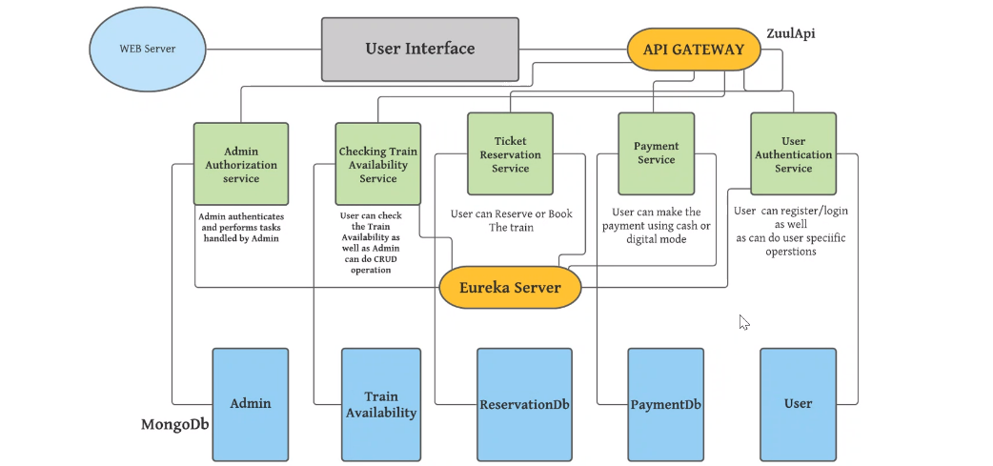







Web-Server
User Interface
(Angular)
API-Gateway
Admin
(8081)
Customer
(8083)
Order
(8082)
Washer
(8003)
Payment
(8004)
Admin
User
Order
Washer
Payment

Slide 2
Back End :
Spring –Boot Frame Work
Mongo Db
Spring Security
Swagger
Spring Cloud

Slide 3
For Front End:
Html
CSS
Bootstrap
Node Js
Angular Frame Work ( Type Script)

